Slide 1
Weekly report: Tower structure
Week number: 09
Date: 25/11/2025
Supervisor: Prof. Faber
Group members: Ibrahim Mostafa, Mohammed Eldemerdash, Kirollos Ghaly
Speaker: Mohammed Eldemerdash (760137)
25/11/2025
1
Speaker: Mohammed Eldemerdash (760137)
Tower structure team/ Optimus Syria

Slide 2
List of contents
Optimizing the tower design.
Modelling the tower on SolidWorks.
Calculation of the eigen frequency
Calculation of the operation range
Campbell diagram with the operational range
Calculation of the deflection angle on tower top
The next task
References
25/11/2025
2
Speaker: Mohammed Eldemerdash (760137)
Tower structure team/ Optimus Syria

Slide 3
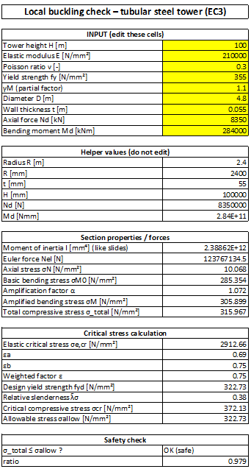
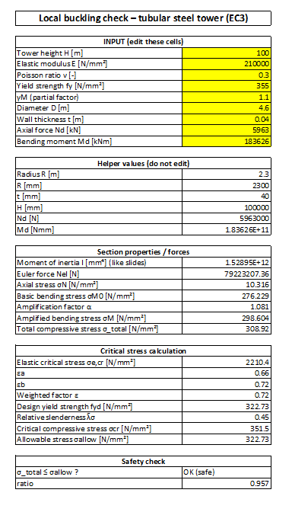
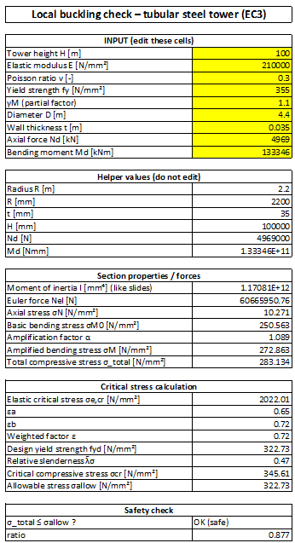

Optimizing the tower design
25/11/2025
3
Speaker: Mohammed Eldemerdash (760137)
Tower structure team/ Optimus Syria

Slide 4
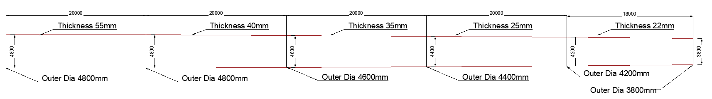
Optimizing the tower design
 | Height | Old values | New values | Outer diameter
First section | H=20 m | t= 55 mm | t= 55 mm | Bottom Do=4.8 m Top Do= 4.8 m
Second section | H=20 m | t= 50 mm | t= 40 mm | Bottom Do=4.8 m Top Do= 4.6 m
Third section | H=20 m | t= 45 mm | t= 35 mm | Bottom Do=4.6 m Top Do= 4.4 m
Fourth section | H=20 m | t= 40 mm | t= 25 mm | Bottom Do=4.4 m Top Do= 4.2 m
Fifth section | H=18 m | t= 35 mm | t= 22 mm | Bottom Do=4.2 m Top Do= 3.8 m
25/11/2025
4
Speaker: Mohammed Eldemerdash (760137)
Tower structure team/ Optimus Syria

Slide 5

Modelling the tower on SolidWorks
Fig : simulation of the tower on SolidWorks
Speaker: Mohammed Eldemerdash (760137)

Slide 6
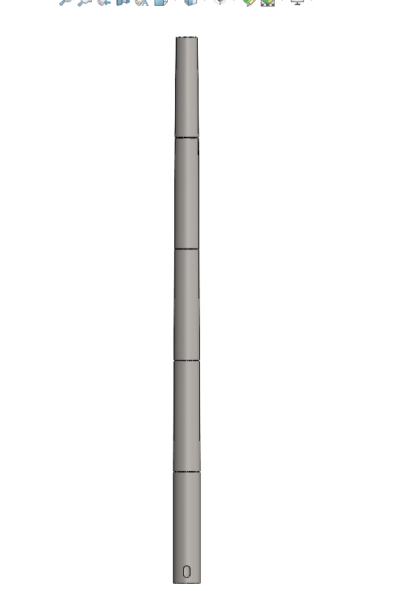
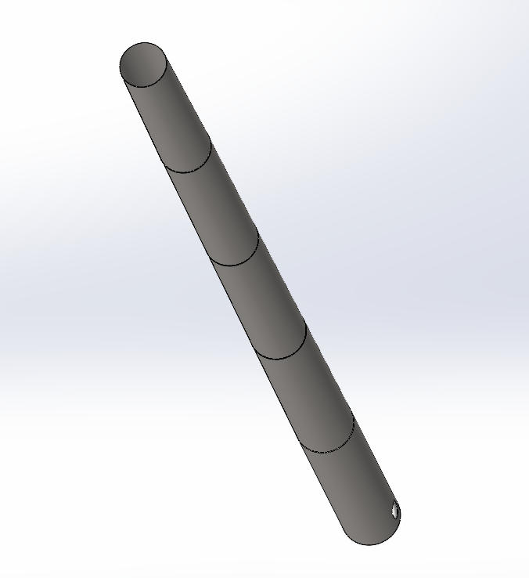
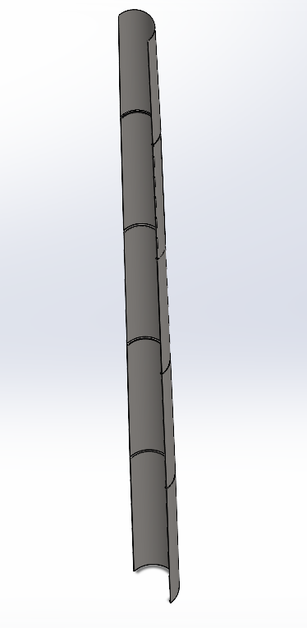
Modelling the tower on SolidWorks
Fig : different views of the tower on SolidWorks
25/11/2025
6
Speaker: Mohammed Eldemerdash (760137)
Tower structure team/ Optimus Syria

Slide 7
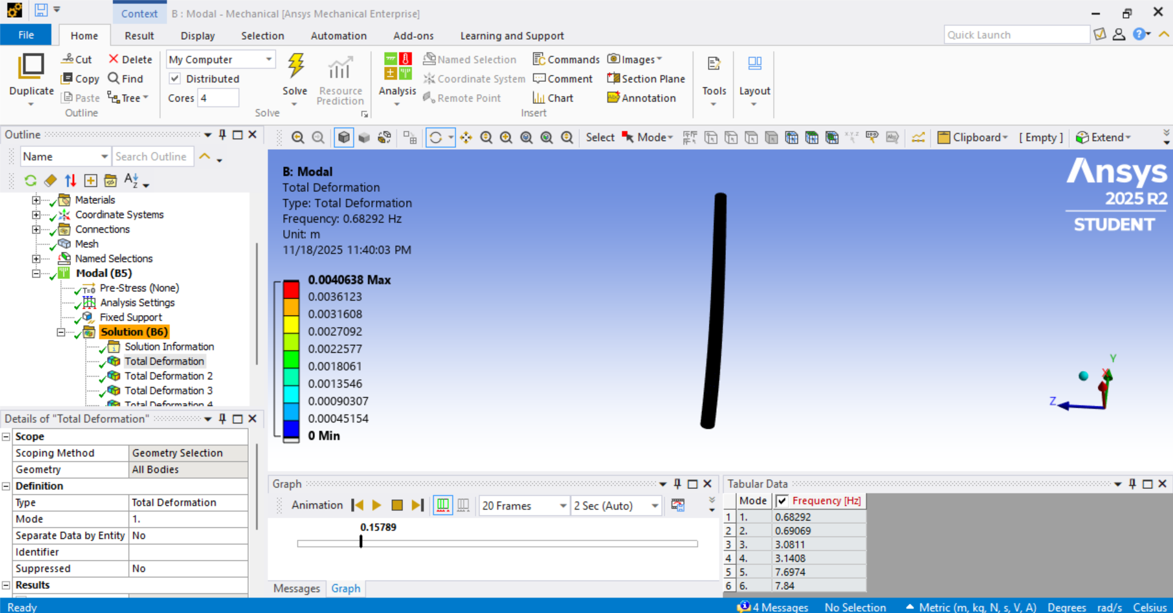
Calculation of the eigen frequency
Fig : calculation of the eigen frequency using Ansys
Speaker: Mohammed Eldemerdash (760137)

Slide 8
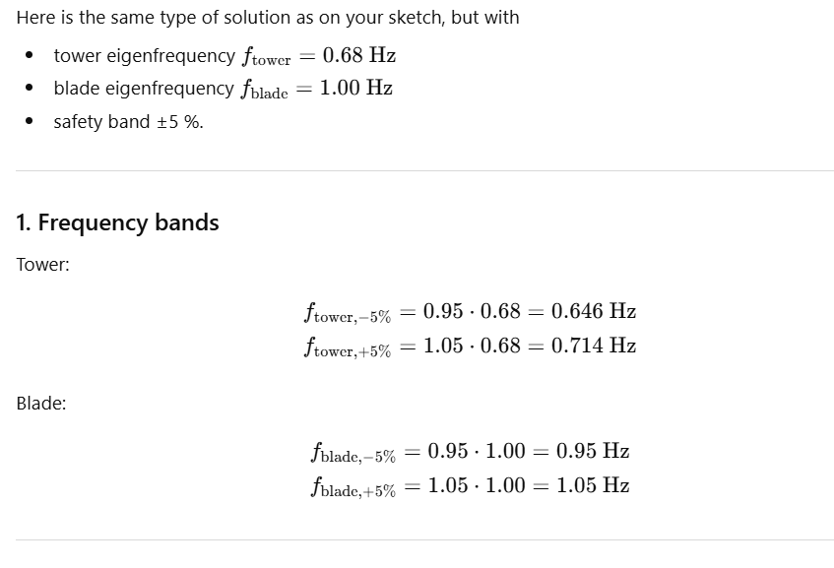
Calculation of the operation range
Speaker: Mohammed Eldemerdash (760137)

Slide 9
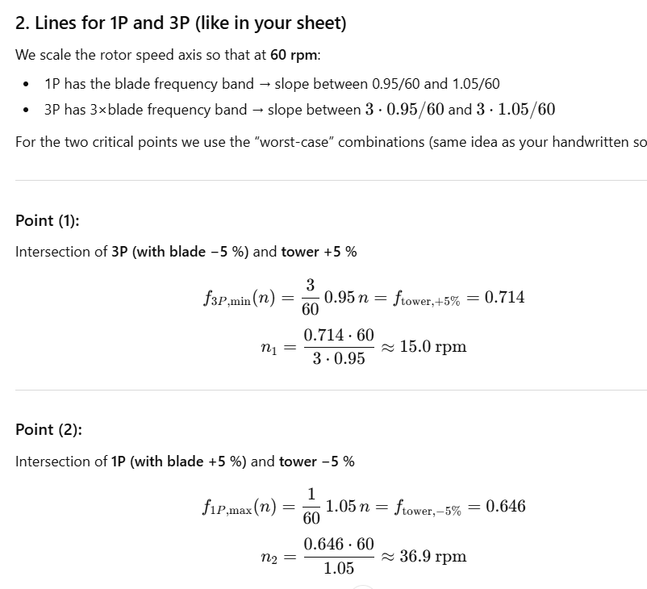
Calculation of the operation range
Good operation range = 15 rpm to 37 rpm
Speaker: Mohammed Eldemerdash (760137)

Slide 10
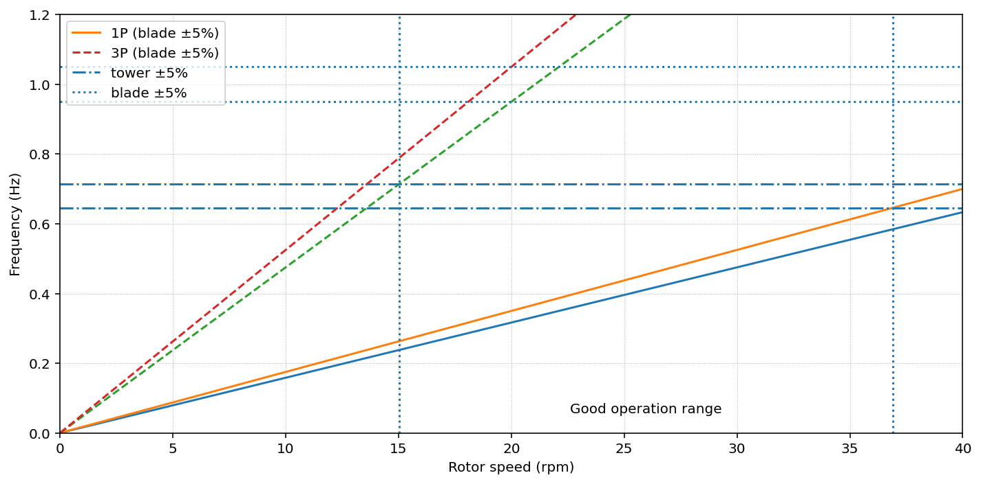
Campbell diagram with the operational range
This is according to SI calculations
3.04
10.65
Fig : operational range of the rotor on campbell diagram
Speaker: Mohammed Eldemerdash (760137)

Slide 11
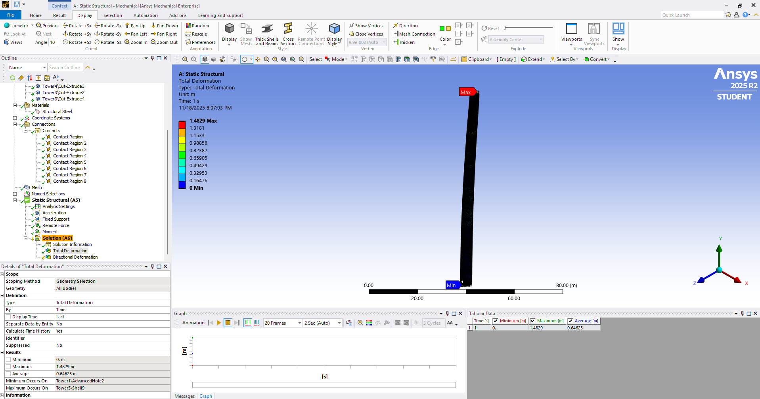
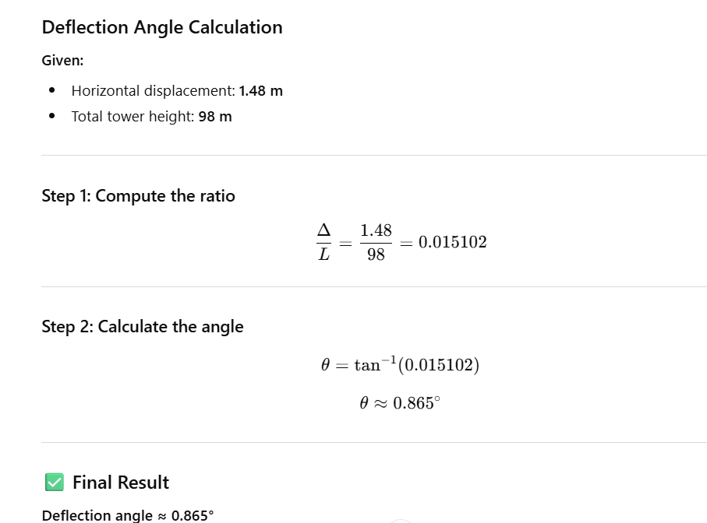
Calculation of the deflection angle on tower top
Fig : calculation of the deflection and deflection angle using Ansys
25/11/2025
Speaker: Mohammed Eldemerdash (760137)

Slide 12
The next task
Design the flange connection
12
Speaker: Mohammed Eldemerdash (760137)
Tower structure team/ Optimus Syria

Slide 13
References
https://www.nrel.gov/wind/data-tools
13
Speaker: Mohammed Eldemerdash (760137)
Tower structure team/ Optimus Syria

